Slide 1
SOCIAL SECURITY
Created in 1945, Social Security is "the guarantee given to everyone that in all circumstances he will have the necessary means to ensure his subsistence and that of his family in decent conditions". Its mission is therefore to protect the French against all the risks of life, by accompanying them at every stage of their lives. It is based on a principle of solidarity, with everyone participating in its financing according to their means.

Slide 2
3 types of diets
Social Security includes 2 main schemes and special schemes, each covering one or more specific socio-professional categories and characterized by different management and coverage methods:
- The general scheme, which covers most of the population: salaried workers, self-employed workers and anyone with residency rights (universal health protection);
- The agricultural scheme, which covers farmers and agricultural employees;
- Many special regimes, such as that of seafarers, mines, SNCF, RATP, EDF-GDF, the National Assembly, the Senate, clerks and notaries' employees.

Slide 3
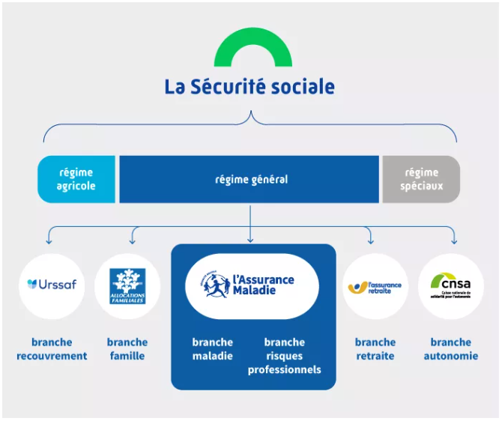
5 branches
A branch is an entity that is responsible for the management of one or more "risks".
These risks are defined as events that can, over the course of a lifetime, affect a person's economic security. They are therefore considered, repared or remunerated.
Social Security is made up of 5 branches:

Slide 4
The collection branch
It collects social security contributions and contributions to redistribute them for the benefit of the other branches.
For the general scheme, the Collection branch is managed by the Urssaf National Fund and is implemented at the local level by the Unions for the Collection of Social Security Contributions and Family Allowances (Urssaf)

Slide 5
The family branch
Its mission is to reduce inequalities in living standards between families by considering the number of children. It manages family benefits. It develops solidarity in 4 specific areas: support for families in their daily lives, childcare, access to housing, the fight against precariousness or disability.
For the general scheme, the family branch is managed by the National Family Allowances Fund (CNAF) and is implemented at the local level by the family allowance funds present throughout the country.
For the agricultural scheme, it is the Mutually Social Agricole (MSA) that ensures this management and implementation.

Slide 6
The health branch
It covers the health expenses of the insured and guarantees access to care. It promotes prevention and contributes to the regulation of the French health system. It covers the risks of illness, maternity, disability and death.
It also manages the occupational risks faced by workers: work accidents, commuting accidents and occupational diseases. As such, it compensates victims and sets the respective contribution of companies to the financing of the system. It implements a policy for the prevention of occupational risks.
For the general scheme, the health branch is managed by the National Health Insurance Fund and its network which consists of the Primary Health Insurance Funds (CPAM), the General Social Security Funds (CGSS) in the overseas departments, the CSS of Mayotte, the Regional Directorates of Medical Service (DRSM), the Pension and Occupational Health Insurance Funds (Carsat), as well as the Unions for the Management of Health Insurance Fund Establishments (Ugecam).
For the agricultural scheme, it is the MSA that ensures this management.
Notes:
CGSS: In the overseas departments and regions (DROM), the General Social Security Funds (CGSS) are responsible for all the social security roles (the "Sickness", "Old age and widowhood" and "Recovery" branches), which are devolved in France to the Unions for the Collection of Social Security Contributions and Family Allowances (Urssaf), the Retirement and Occupational Health Insurance Funds (Carsat) and the Primary Health Insurance Funds (CPAM). Only the benefits of the "Family" branch are provided by autonomous Family Allowance Funds (CAF).
CSS Mayotte: The Social Security Fund of Mayotte is part of the national Social Security network. It is responsible for collecting social security contributions and distributing social benefits on the territory of Mayotte. A private law body, it has been managing all branches since 1 January 2015: illness, accidents at work and occupational diseases, retirement, recovery and family.

Slide 7
The pension branch
It pays pensions to retirees in industry, services and commerce. Present from their first job, it follows employees throughout their careers and helps them prepare for retirement.
For the general scheme, the pension branch is managed by the National Old-Age Insurance Fund and in the field by the Retirement and Occupational Health Insurance Funds (Carsat).
For the agricultural scheme, it is the MSA that ensures this management.

Slide 8
The autonomy branch
It manages the expenses related to the autonomy of the elderly and disabled people, whether it is the financing of the establishments and the services that accompany them, or the individual assistance paid to them. It also carries out prevention, anti-isolation, information, prospective and research actions.
The autonomy branch is managed by the National Solidarity Fund for Autonomy (CNSA) in conjunction with its networks: the departmental councils, the departmental homes for people with disabilities and the regional health agencies.

Slide 9
The Institute 4.10

Slide 10
The ADN of the Institut 4.10
Pedagogy of success
Skills-based training
Our pedagogical signature is based on five foundations that form the very essence of our action in the service of the success of each learner.
It embodies our desire to create a meaningful learning experience in line with learners' learning objectives and skills development.
The 4 pillars of learning
The group: Learning engine
The trainer as a mediator

Slide 11
Pedagogy of success
Skills-based training
Our pedagogical approach places success at the center.
We believe that success breeds motivation and our pedagogical approach aims to build trust, autonomy and a caring relationship. Each training is designed to promote individual growth, emphasizing motivating methods and constructive evaluations.
Our programs are carefully developed, focused on essential skills. Each training module is built and evaluated according to the targeted skills, ensuring direct relevance to the requirements of the learners' current professional situation. We emphasize a practical approach, allowing trainees to acquire tangible skills and abilities that are immediately applicable.

Slide 12
The 4 pillars of learning
Capturing attention The "hooks", capable of generating and reactivating attention: emotions, priority to the meaning of the messages, starting from the "already there", i.e. the representations of the apprentices, storytelling, variety of pedagogical methods
Formalize feedback Receiving immediate feedback on the action in progress is a part of learning, even in the event of a mistake. The closer and more constructive the feedback, the more effective and integrated the corrective action will be in a sustainable way. This feedback can be provided by the trainer, tutor or peers.
Ensuring consolidation New knowledge and know-how require the establishment of a reinforcement mechanism to anchor them in the long term. The automation of knowledge and procedures requires repetition and training over time,
Foster active engagement Practical activities, work in small groups, problem solving, field application, simulation, requirement of reflection on the practice and its learning...

Slide 13
The group: Learning engine
The trainer as a mediator
Beyond their experience, the trainer guides each learner in their skills acquisition process by fostering a stimulating learning environment. The speakers do not limit themselves to disseminating knowledge, they act as mediators of learning and develop an interactive relationship conducive to the process of acquiring new skills
Promoting group dynamics is at the heart of our learning, Our trainings are structured to exploit the richness of interactions between participants, collaboration and mutual learning, thus transforming the group into a collective learning engine

Slide 14
The Institute 4.10: Training, Supporting, Advising Social Protection Actors
We support Social Security staff in the acquisition and development of new skills through 9 categories: Customer relations Management and steering Support professions Health and safety Human resources Control and regulation Computer science Professional efficiency Professional career paths
All training can be provided in Social Security organizations or on one of our training sites

Slide 15
An example: C2S Training Membership Module
The CCSM of Mayotte has deployed access to the C2S (Complementary Health Solidarity) right on its territory since January 1, 2024.
A team has been recruited to support the C2S instructions. The technicians were trained in January 2024 on access to the law, the examination of an application, the notification of decisions, but had not been trained on the membership module, which represents the stage of the concretization of the C2S right with financial participation.
The 4.10 Institute has designed an adapted training course to finalize the initial increase in competence on the C2S
Pedagogical approach and evaluation method: - 2-hour training provided remotely - Technical contributions - On-the-spot evaluation at the end of the training
Training objectives: - Analyze requests - Enforce regulations and processing procedures (C2S with and without financial participation) - To process requests and complaints related to the activity (including complex files)
Educational objectives: - Measuring eligibility and registering entitlement - Managing the complex situations inherent in the attribution of the right

